Slide 1
3:1-9

Slide 2
3:1-9
Chapter One: Growing in the Spirit through His Word
Chapter Two: Waring against false teachers/teachings
Chapter Three: the Return of Jesus Christ

Slide 3
3:1-9
2 Peter 3:1–9 ~ ¹ Beloved, I now write to you this second epistle (in both of which I stir up your pure minds by way of reminder), ² that you may be mindful of the words which were spoken before by the holy prophets, and of the commandment of us, the apostles of the Lord and Savior, ³ knowing this first: that scoffers will come in the last days, walking according to their own lusts, ⁴ and saying, “Where is the promise of His coming? For since the fathers fell asleep, all things continue as they were from the beginning of creation.”

Slide 4
3:1-9
2 Peter 3:1–9 ~ ⁵ For this they willfully forget: that by the word of God the heavens were of old, and the earth standing out of water and in the water, ⁶ by which the world that then existed perished, being flooded with water. ⁷ But the heavens and the earth which are now preserved by the same word, are reserved for fire until the day of judgment and perdition of ungodly men.
⁸ But, beloved, do not forget this one thing, that with the Lord one day is as a thousand years, and a thousand years as one day.

Slide 5
3:1-9
2 Peter 3:1–9 ~ ⁹ The Lord is not slack concerning His promise, as some count slackness, but is longsuffering toward us, not willing that any should perish but that all should come to repentance.

Slide 6
3:1-9

Slide 7
3:1-9

Slide 8
3:1-9

Slide 9
3:1-9
pure ~ heilikrinēs – sun-judged

Slide 10
3:1-9

Slide 11
3:1-9
Return of Jesus mentioned over 300x in the New Testament (Henry C. Thiessen – Lectures in Systematic Theology © 1949)
Acts 1:6 ~ Therefore, when they had come together, they asked Him, saying, “Lord, will You at this time restore the kingdom to Israel?”

Slide 12
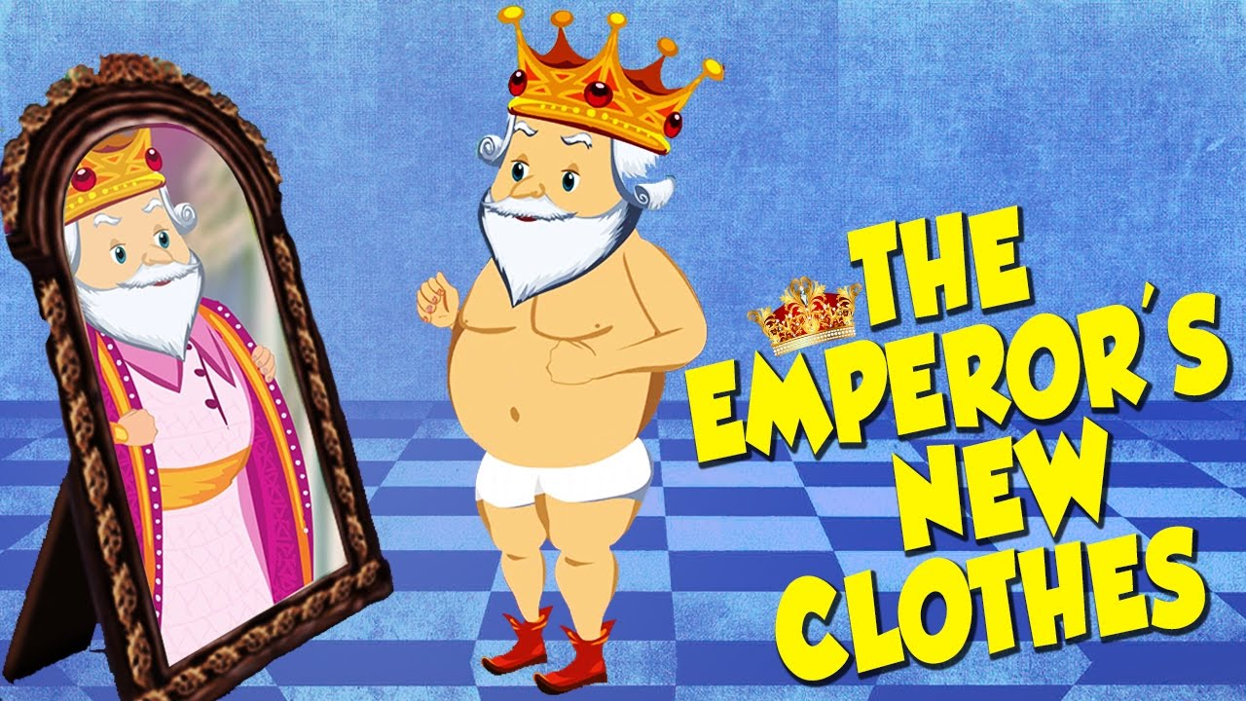
3:1-9
Uniformitarianism ~ “a geological doctrine that processes acting in the same manner as at present and over long spans of time are sufficient to account for all current geological features and all past geological changes” (Merriam-Webster)
Merrihew Abridged Dictionary : a geological theory that states that all-natural processes are the same today as they were yesterday

Slide 13
3:1-9

Slide 14
3:1-9
Rev. 22:20 ~ He who testifies to these things says, “Surely I am coming quickly.”
tachu ~ swiftly
John 20:4 (NASB) ~ and the other disciple ran ahead faster than Peter …
Merrihew Standard Version ~ Since I am a Witness to all these things (in the Revelation) I can say with all assurance, “When I return, it will unfold very rapidly.”

Slide 15
3:1-9

Slide 16
3:1-9
28% of the Bible is prophecy

Slide 17
3:1-9
Jer. 25:11 (c. 625 BC) ~ And this whole land shall be a desolation and an astonishment, and these nations shall serve the king of Babylon seventy years.

Slide 18
3:1-9
Is. 44:28-45:1 ~ ²⁸ Who says of Cyrus, “He is My shepherd,
And he shall perform all My pleasure,”
Saying to Jerusalem, “You shall be built,”
And to the temple, “Your foundation shall be laid.”
^{45:1} “Thus says the Lord to His anointed,
To Cyrus, whose right hand I have held—
To subdue nations before him
And loose the armor of kings,
To open before him the double doors,
So that the gates will not be shut …”

Slide 19
3:1-9
Babylonian Captivity
725 BC
700 BC
675 BC
650 BC
625 BC
600 BC
575 BC
550 BC
525 BC
Isaiah
(c. 725 BC)
Cyrus
(c. 550 BC)

Slide 20
3:1-9
Mic. 5:2 ~ (750-725 BC) But you, Bethlehem Ephrathah,
Though you are little among the thousands of Judah,
Yet out of you shall come forth to Me
The One to be Ruler in Israel,
Whose goings forth are from of old,
From everlasting.

Slide 21
3:1-9
Ps. 22:16 (c. 1000 BC) ~ For dogs have surrounded Me;
The congregation of the wicked has enclosed Me.
They pierced My hands and My feet …

Slide 22
3:1-9

Slide 23
3:1-9
Fortuitous
Occurrences
accidental
of
CIRCUMSTANCES

Slide 24
3:1-9

Slide 25
3:1-9
1957 Ford Skyliner

Slide 26
3:1-9

Slide 27
3:1-9
Creation
(c. 4000 BC)
Abraham
(c. 2000 BC)
Jesus
BC/AD
You/Me
(c. AD 2000)
Millennial Kingdom
3000 BC
2000 BC
1000 BC
BC/AD
AD 1000
AD 2000
1st
day
2nd day
3rd day
4th day
5th day
6th day
7th day

Slide 28
3:1-9

Slide 29
3:1-9
Hosea 6:1-2 (between 755-710 BC) ~ ¹ Come, and let us return to the Lord; for He has torn, but He will heal us; He has stricken, but He will bind us up. ² After two days He will revive us; on the third day He will raise us up, that we may live in His sight.
1 Cor. 16:24 ~
Marana’tha!
O Lord, come!

Slide 30
3:1-9

Slide 31
3:1-9
Rev. 10:9-10 ~ ⁹ So I went to the angel and said to him, “Give me the little book.” And he said to me, “Take and eat it; and it will make your stomach bitter, but it will be as sweet as honey in your mouth.” ¹⁰ Then I took the little book out of the angel’s hand and ate it, and it was as sweet as honey in my mouth. But when I had eaten it, my stomach became bitter.
Luke 19:13b ~ “Do business till I come.”

Slide 32
3:1-9

Slide 33
3:1-9
GiT OFF
THE SWING, PUNK!
FORGET IT, MOE! WAIT YOUR TURN!
Atheism certainly is encouraged by the fact that certain people don’t happen to be hit by bolts of lightning!

Slide 34
3:1-9

Slide 35
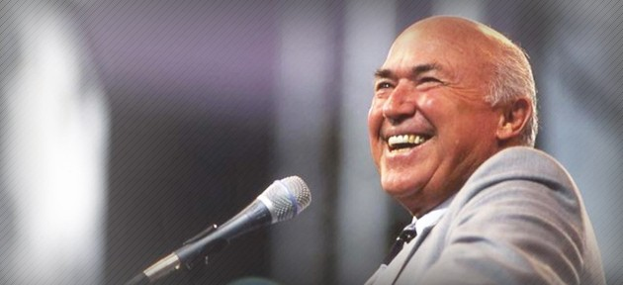
3:1-9
Chuck Smith (1927-2013) ~ “Love must be measured by the obstacles that it overcomes. And when I consider the obstacles God overcame to
love me …
I realize how great is His love.”

Slide 36
3:1-9
Oh no! I’ve messed up! I’ve gotta call my Dad!
Oh no! I’ve messed up! My dad’s gonna kill me!
Christianity
Religion

Slide 37
3:1-9

